Slide 1
Design Projects
12/18 Final Presentations (11:30-2:00 pm in 162) Final Report due
Send me PowerPoint or Google slide link by 10 am on 12/18
15 minutes per team
Don’t mess up on the timing!
Practice!
Make it educational and fun for your classmates!

Slide 2
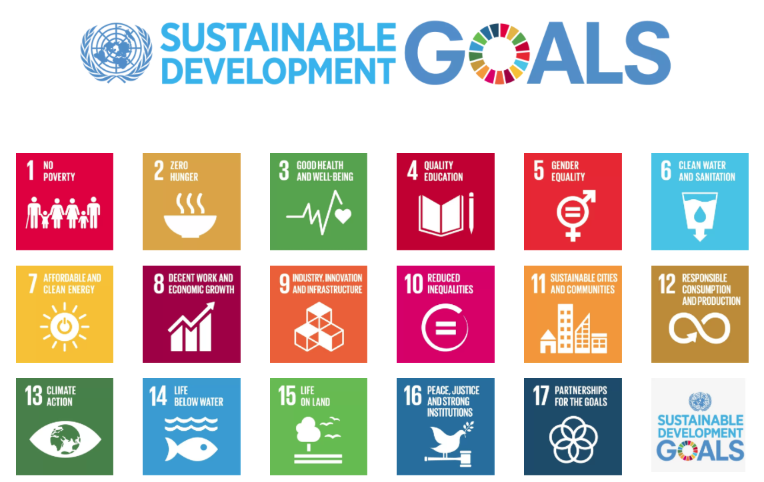
2015 to 2030
Notes:
On 1 January 2016, the 17 Sustainable Development Goals (SDGs) of the 2030 Agenda for Sustainable Development — adopted by world leaders in September 2015 at an historic UN Summit — officially came into force. Over the next fifteen years, with these new Goals that universally apply to all, countries will mobilize efforts to end all forms of poverty, fight inequalities and tackle climate change, while ensuring that no one is left behind.
http://www.un.org/sustainabledevelopment/development-agenda/

Slide 3

At least 1.8 billion people use a source of drinking water contaminated with feces
More than 80% of wastewater is discharged without any pollution removal

Slide 4

SDG 6.1: By 2030, safe and affordable drinking water for all
Some three in ten people (2.3 billion) lack access to safe and readily available water at home
Additional 1.2 billion from population growth gives 3.5 billion need water by 2030
267 million people per year! (1 Indonesia/year)
At 3 mL/s per person we need 800,000 L/s per year of new installed capacity
Notes:
http://www.un.org/sustainabledevelopment/blog/2017/07/billions-around-the-world-lack-safe-water-proper-sanitation-facilities-reveals-un-report/

Slide 5
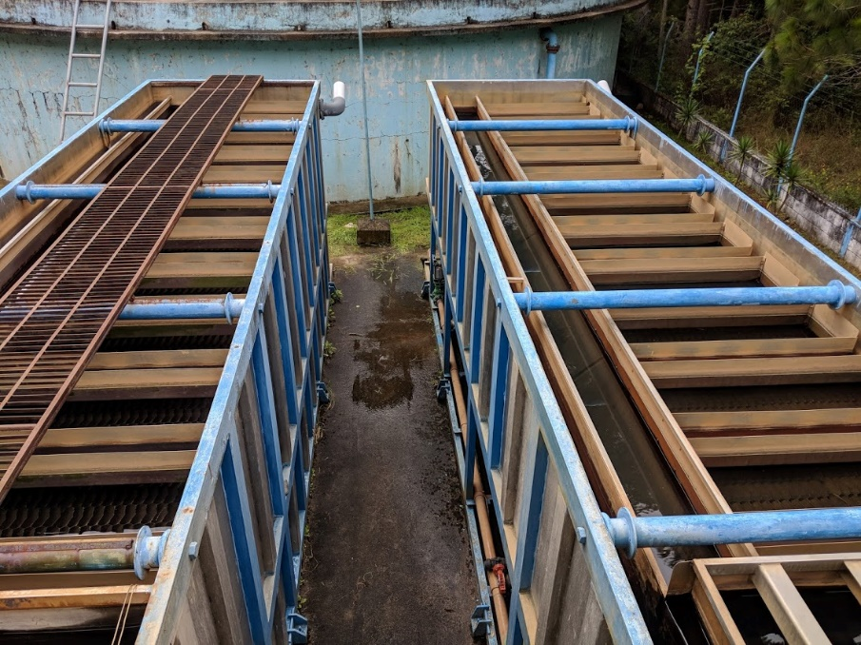
4.9 billion need new water supply systems by 2030
48 year lifetime
12 years until 2030
25% of existing plants need to be replaced
Supposedly 5.6 billion have safe water on tap
1.4 billion need upgraded systems by 2030

Slide 6
US Water Infrastructure
ASCE Infrastructure Grade is D+
What you’ve learned in this course is completely applicable to designing new and upgrading existing water treatment infrastructure anywhere on this planet
You have the latest insights into the core water treatment processes – the only course on the planet that teaches this material!

Slide 7
Resilient Designs are needed in the United States too!
NYC blackout of 1977
Boeing Max 8 substituted a stable aeronautic design for software feedback control
Design for steady state (cruising at flight elevation) is easy
Design for rapid startup after disasters (with disrupted supply chains) is much harder
Notes:
Manual operation fully enabled (Max 8 lesson)
Use physics rather than software to enable reliable operation
Smart hydraulics (example of StaRS flow control system)
https://theaircurrent.com/aviation-safety/what-is-the-boeing-737-max-maneuvering-characteristics-augmentation-system-mcas-jt610/
By moving the larger and more fuel efficient engine slightly forward and higher up they increased fuel efficiency by 14%
Caused an increased moment on the aircraft causing it to tend to rotate the nose up.
Connect water treatment plant design to Max 8 aircraft.
Separate control and monitoring

Slide 8
Bringing Advanced Tech to the U.S.
We have an National Science Foundation proposal so that we can conduct additional research and move closer to commercializing AguaClara tech in the U.S.
CEE 4590 project will be a 20,000 L/s water treatment plant for Los Angeles California

Slide 9
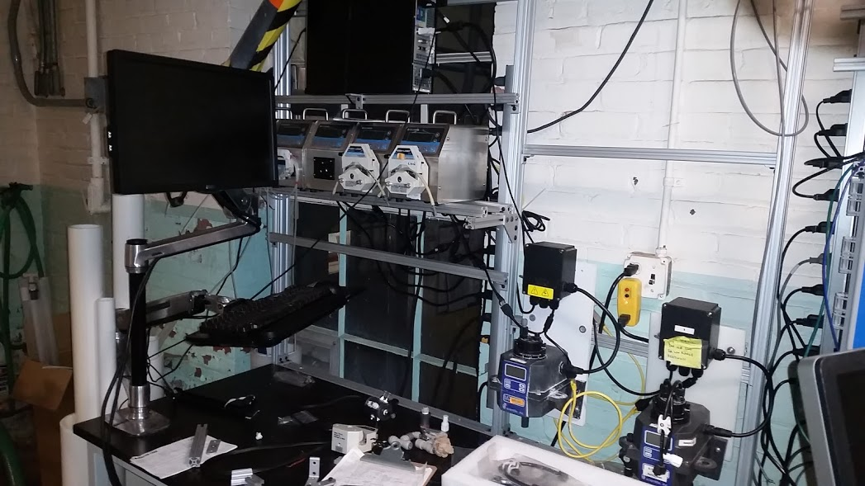
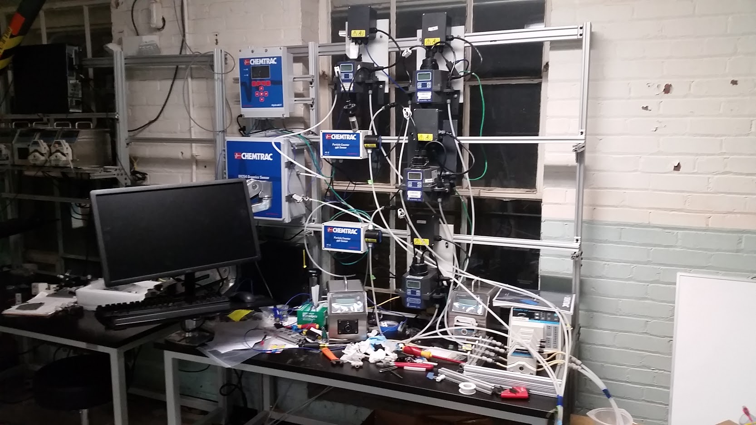
Cornell Water Filtration Plant

Slide 10
Challenges on the horizon
Standard designs for flow rates from 1 to 240 L/s
Retrofit designs for larger flat bottom sed tanks (take the case of 10 m square tanks)
Wide range of water contaminants (expand to fluoride, arsenic, wastewater, reuse)
Biggest challenge of all – create enough momentum so that new technologies are adopted and sustained

Slide 11
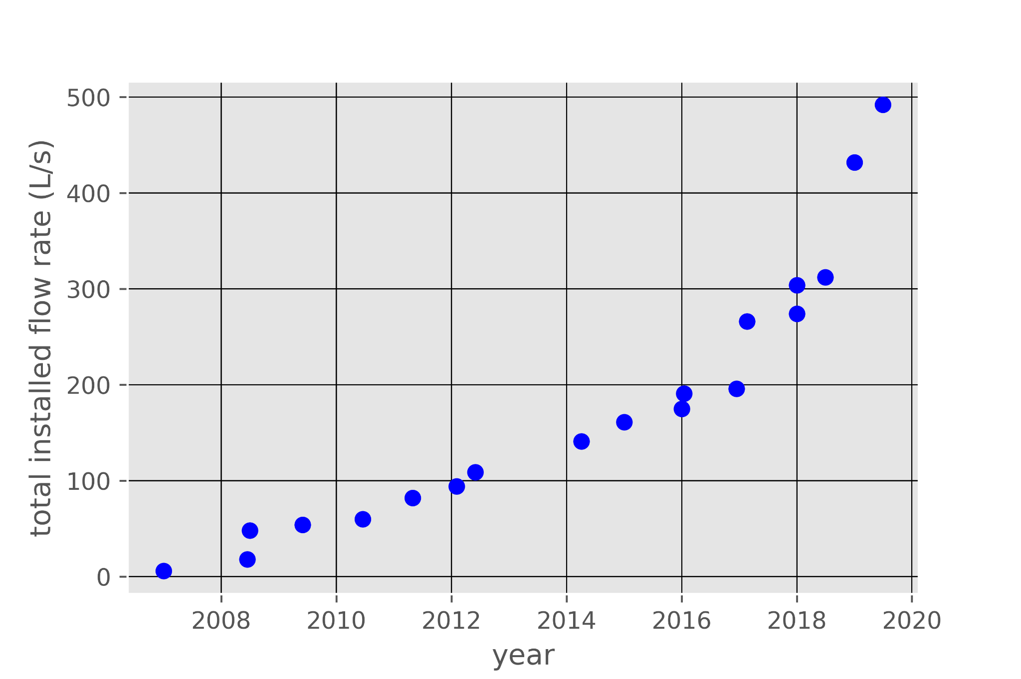
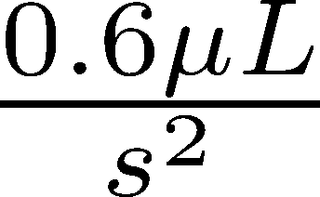
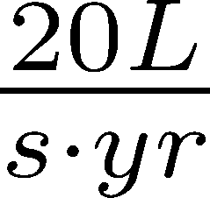
AguaClara installed capacity is increasing steadily (and slowly)

Slide 12
Time for acceleration
We need 800,000 L/s per year of new installed capacity
AguaClara = 20 L/s per year – need to increase rate by a factor of 40,000
Disruptive technologies must be at least twice as good as traditional technologies (marketing is critical too!)
Our ongoing research to improve water treatment technologies is critical to increase the rate
Open source engineering is also a disruptive new approach to spreading technologies

Slide 13
The transition is underway with a significant increase in rate!
Ocotal
Gracias
San Rafael del Norte
Zamorano
La Concordia
Las Vegas

Slide 14
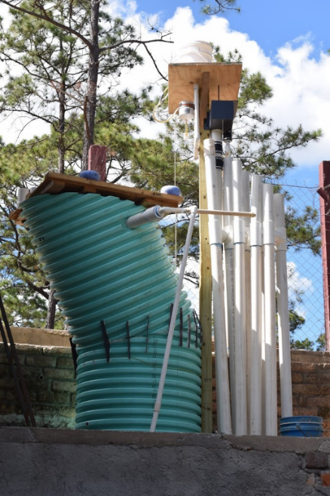
New Opportunities
Million village challenge
Possibly adapted to remove arsenic and fluoride
Demonstrate new technologies at far lower cost ($10k rather than $100+k)

Slide 15
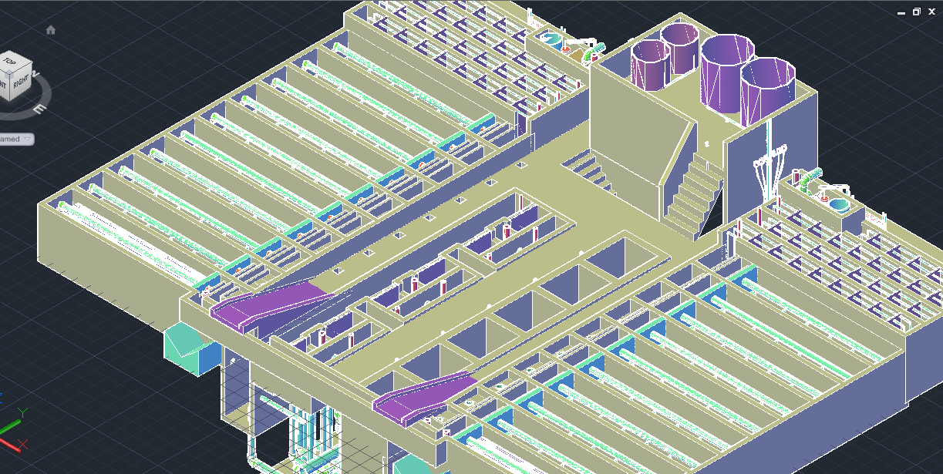
120 L/s AguaClara plant (draft design for Gracias, Honduras)
Meghan Furton M.Eng. 2017

Slide 16
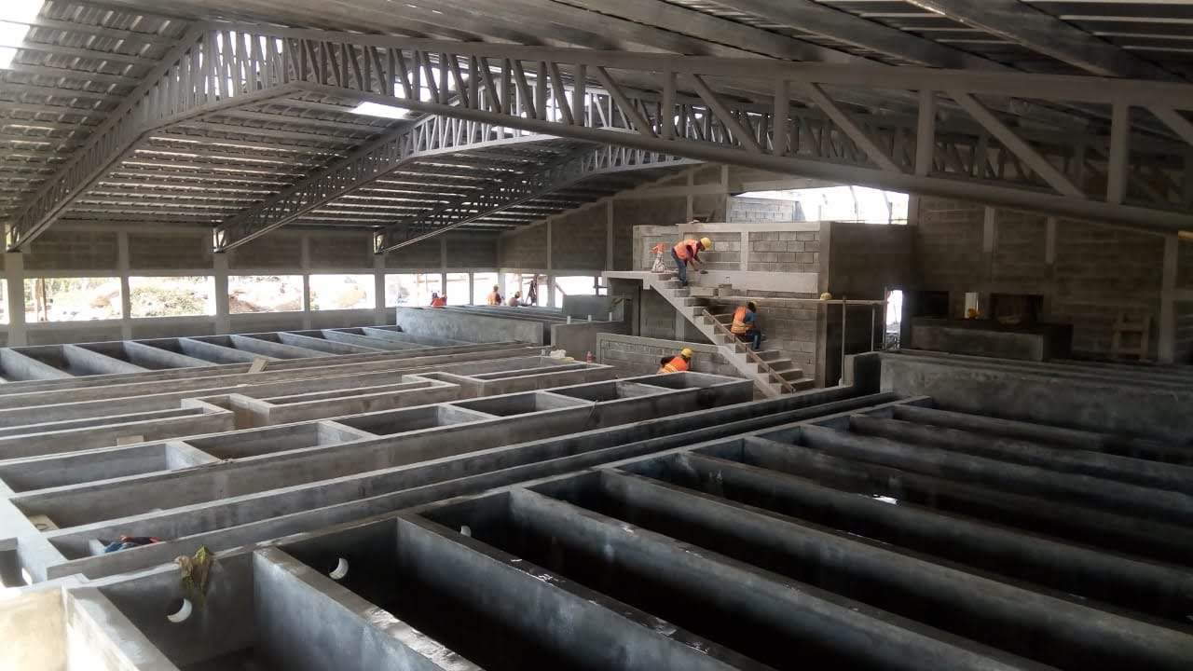
Gracias on April 12, 2019

Slide 17
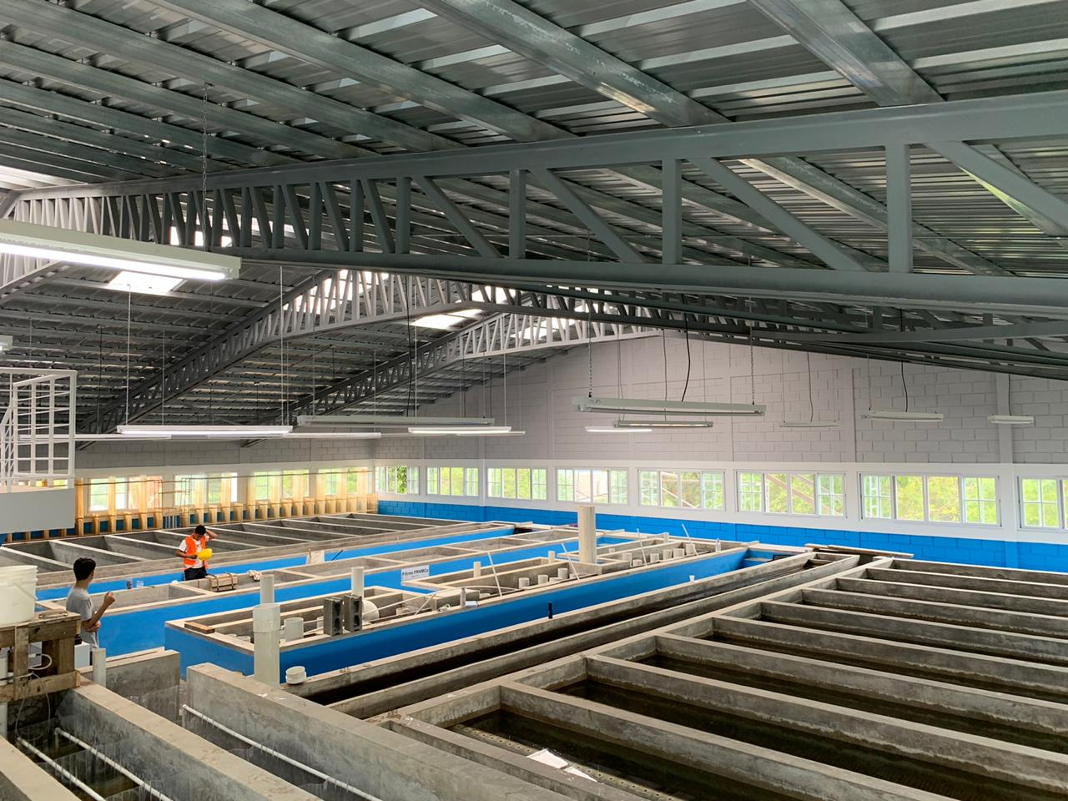

Slide 18
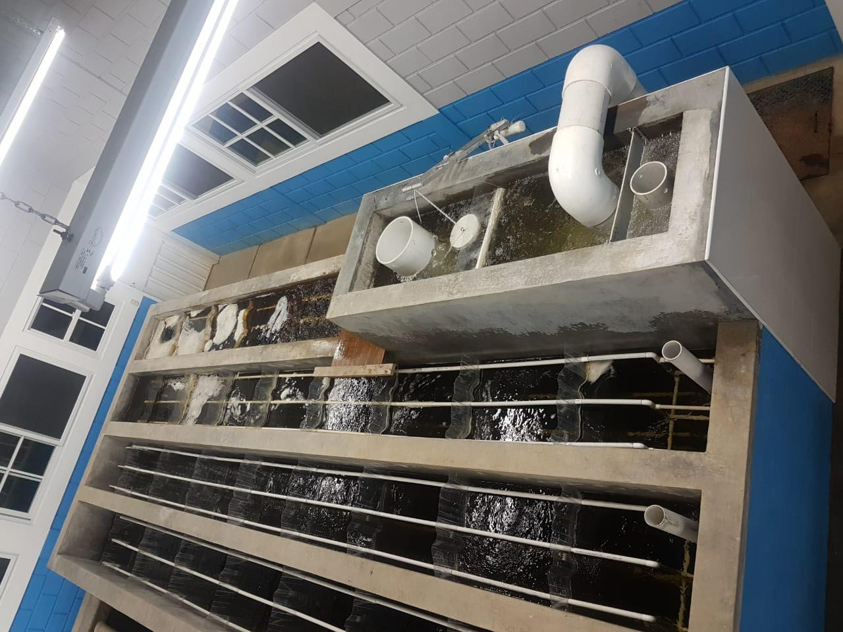

Slide 19
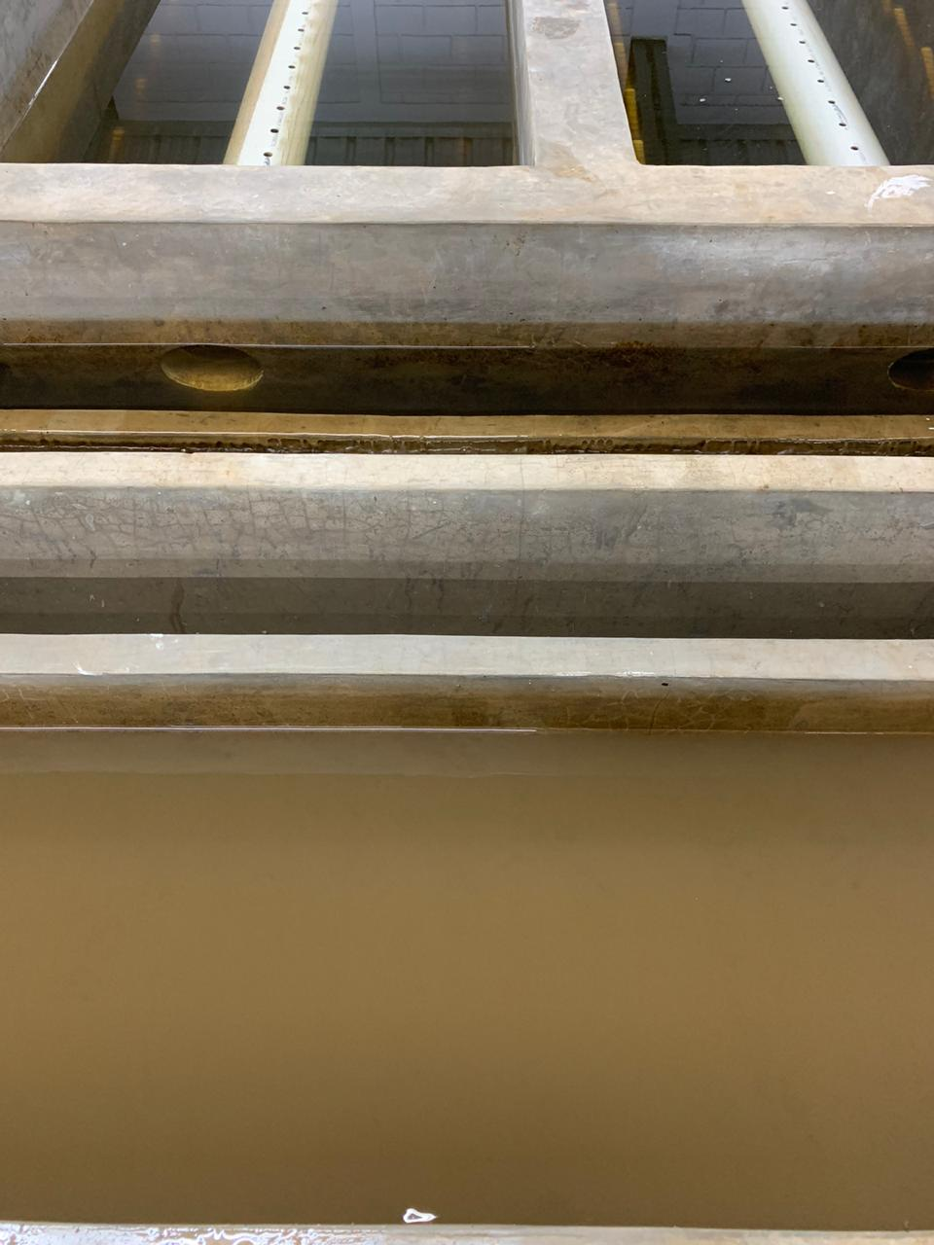
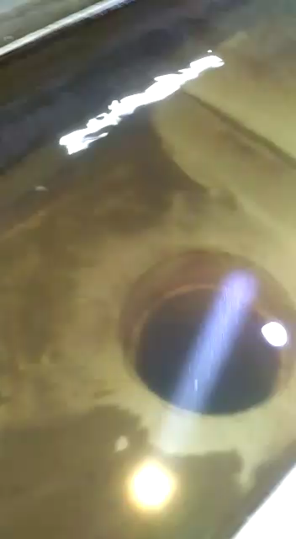
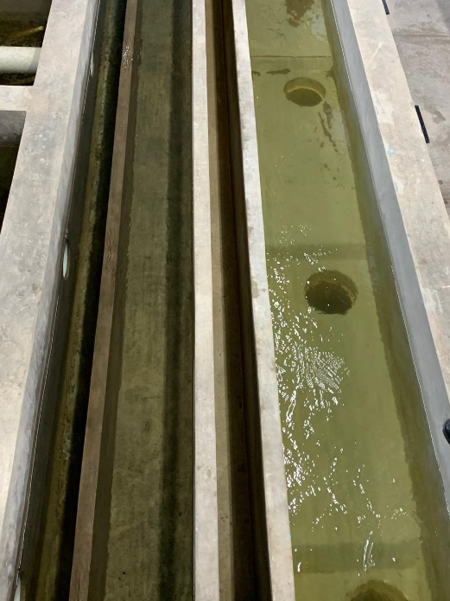

Slide 20
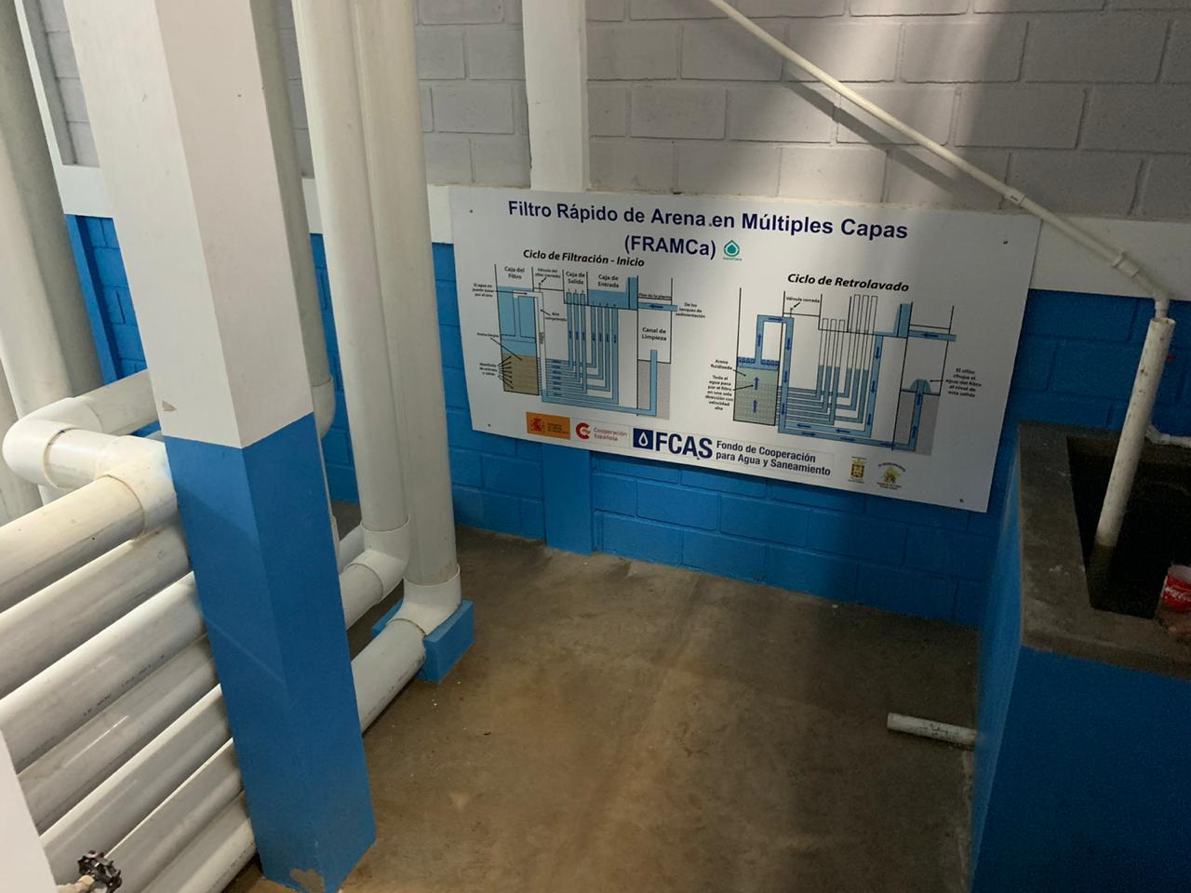

Slide 21
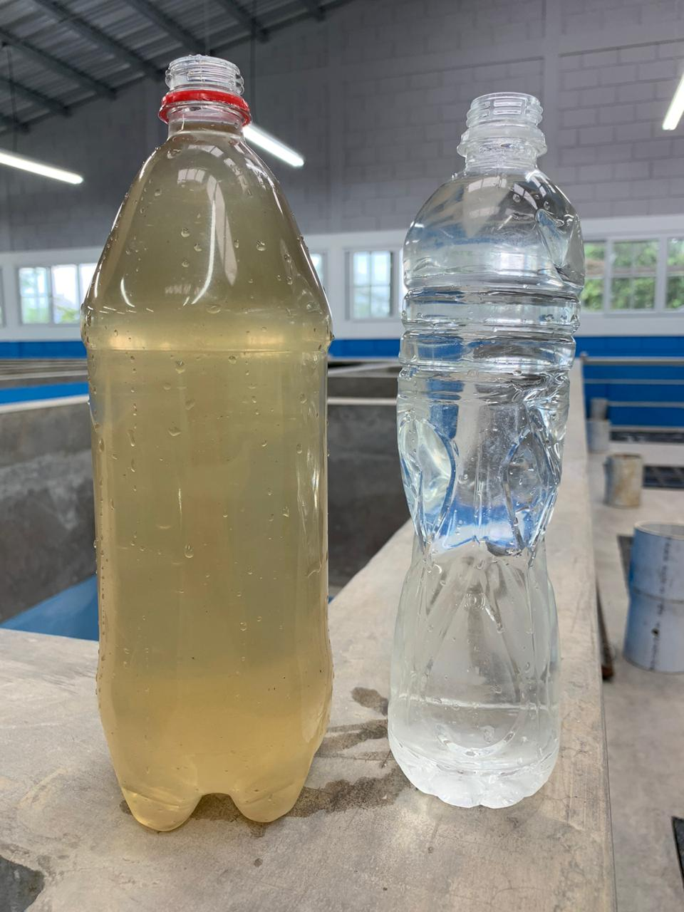

Slide 22
Challenges in Honduras
Clear water with high concentration of dissolved organics
High coagulant dose required
Polymer required to make larger flocs
2 hr runtimes on StaRS filters at Gracias
Diagnose the problem

Slide 23
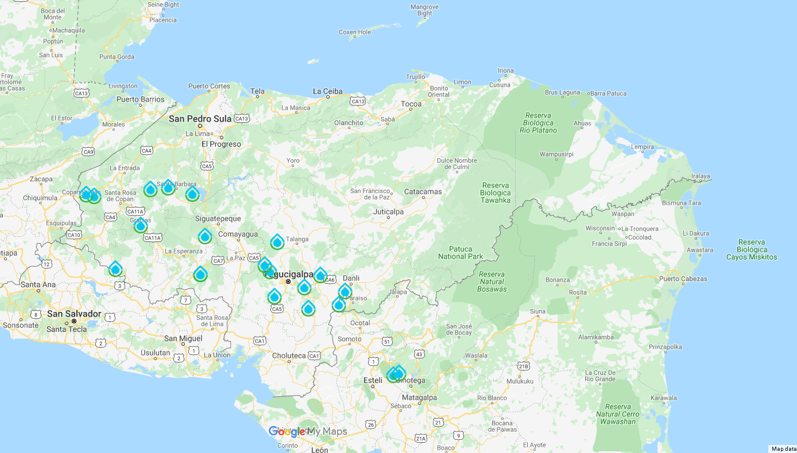
Gracias: Inaugurated! First plant to use an anionic polymer in addition to PACl to treat water with high concentration of dissolved organics

Slide 24
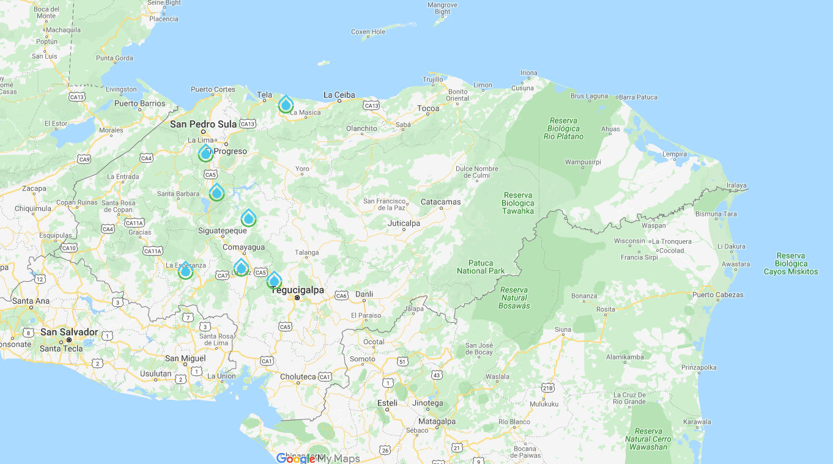
Esparta: has made the first step with the Spanish Cooperation for financing. The assistant mayor attend the Gracias inauguration

Slide 25
Villanueva Cortes: requested a presentation about AguaClara, visited the Gracias plant, are exploring contracting for a design of a 200 L/s plant

Slide 26
Santa Cruz de Yojoa: are formulating a plan to request funding from the Spanish Cooperation for a 200 L/s water treatment plant.

Slide 27
La Libertad: requested an update on the AguaClara designs that were created by May Sharif in 2013.

Slide 28
Esperanza and Intibucá: mayors selected AguaClara for one water sources. Project is on hold due to lack of right of way for a critical section of the transmission line

Slide 29
La Paz: requested an AguaClara design, then changed their mind and selected a CEPIS design that uses direct filtration (no flocculation or sedimentation) instead

Slide 30
Las Moras: Their plant came on line a few weeks ago without filters. They hope to build filters while we are in Honduras in January

Slide 31
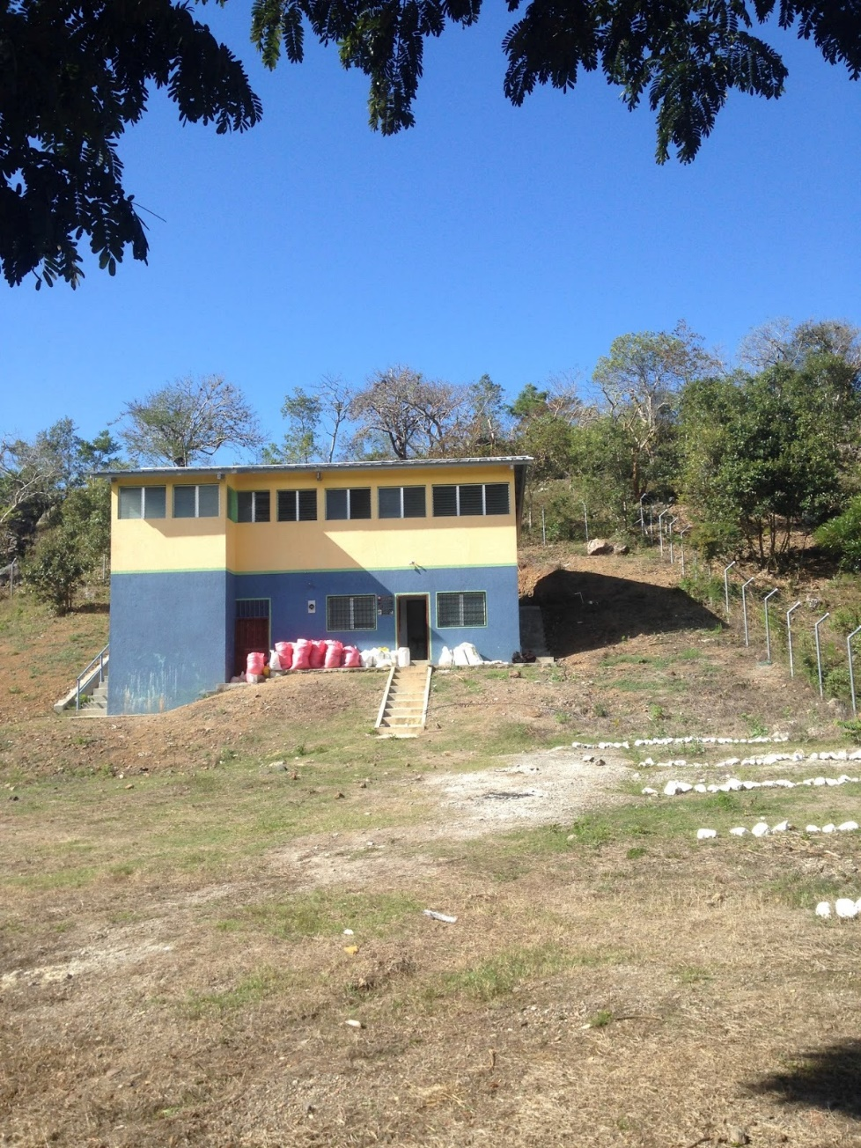
November, 2019: A Rural Water Workshop In Honduras
APP engineer, Santiago Garcia, presented the AguaClara technology
Workshop participants went to visit the AguaClara plant at Jesús de Otoro
Pedro Ortiz, government water engineer, stated that the only group in Latin America that is investigating low cost water treatment is AguaClara: “la major en el mundo”

Slide 32
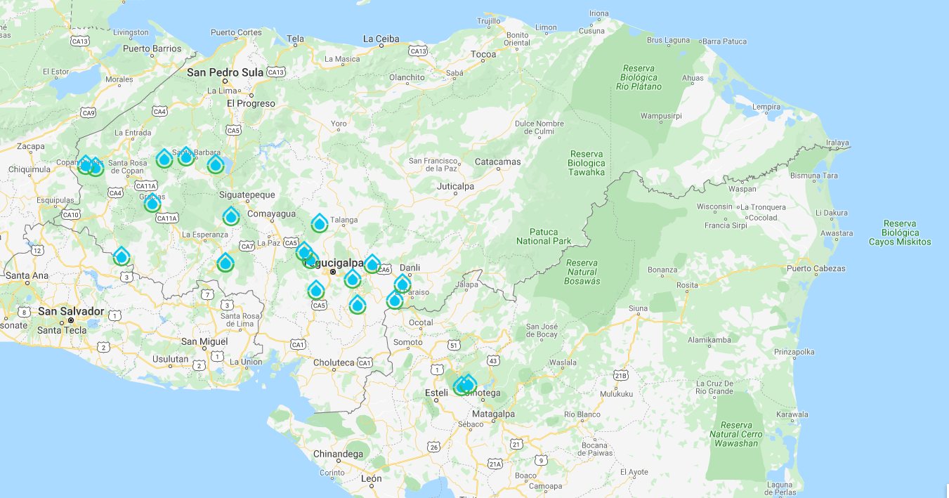
AguaClara in Central America 21 towns – 85,000 people

Slide 33
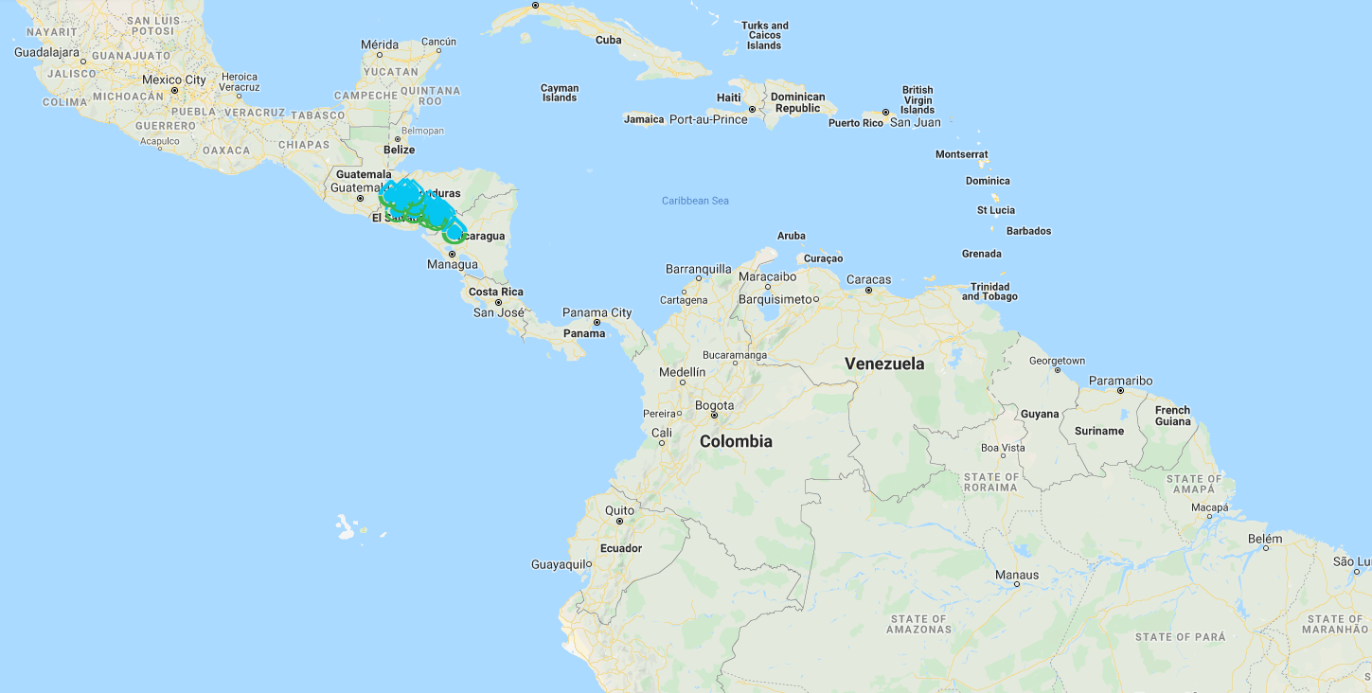
Colombia: Cauca. Exploration of building 20 and 40 L/s plants for two town. Networking!!!!

Slide 34
You conquered Colab, Python, and the AguaClara package
Justin, Nina, and Jacqueline are amazing people and outstanding teachers
You demonstrated your ability to learn with minimal guidance
You are wonderful people! Thank you!
AguaClara Cornell needs you!
So many mysteries to solve!

Slide 35
Connecting Meaning to Graduate School and Professional Careers
Four steps toward a better world
Measure stuff (often sufficient for a Ph.D.)
Create models of how our universe works (based on observations) (fundamental science)
Invent new solutions based on good models of how our universe works (inventing!)
Engage with the world to implement those solutions (engineering!)
Our planet needs bold engineers and scientists who engage to create a better world
Engaging with real world problems facilitates inventions
Notes:
You can get a Ph.D. doing step 1 sometimes.
Step 2 is great for getting a Ph.D.
Steps 3 and 4 are much harder!

Slide 36
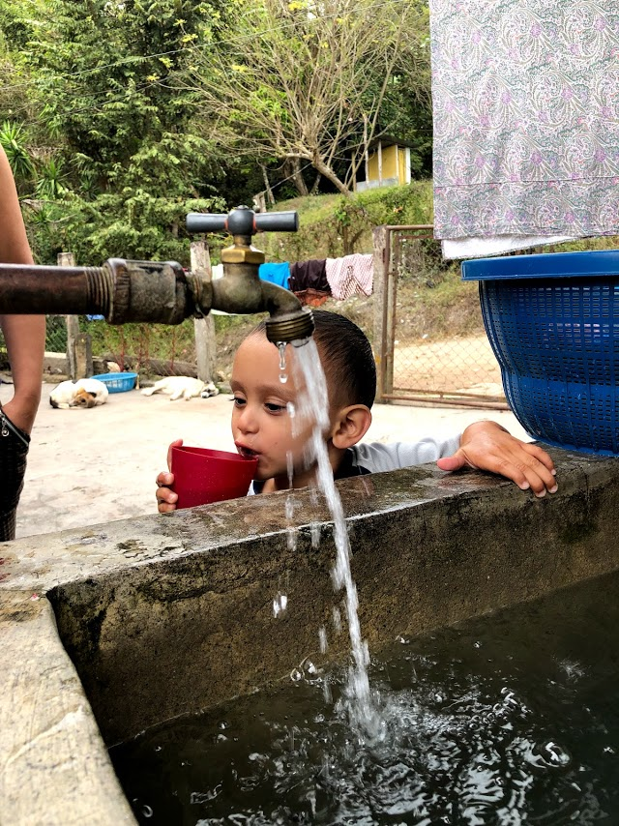
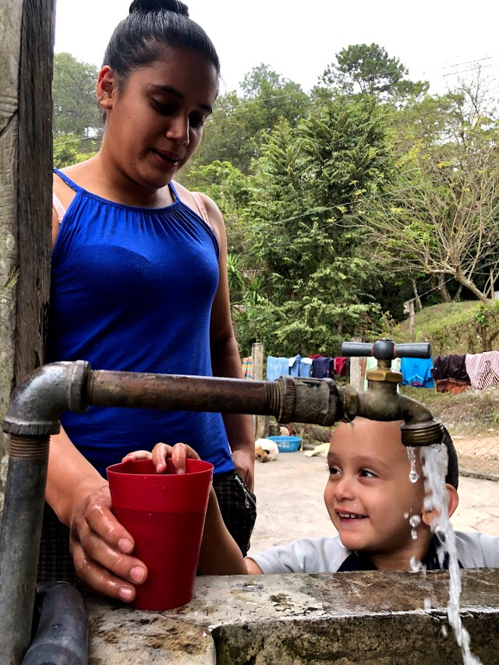
Happiness is safe water on tap

Slide 37
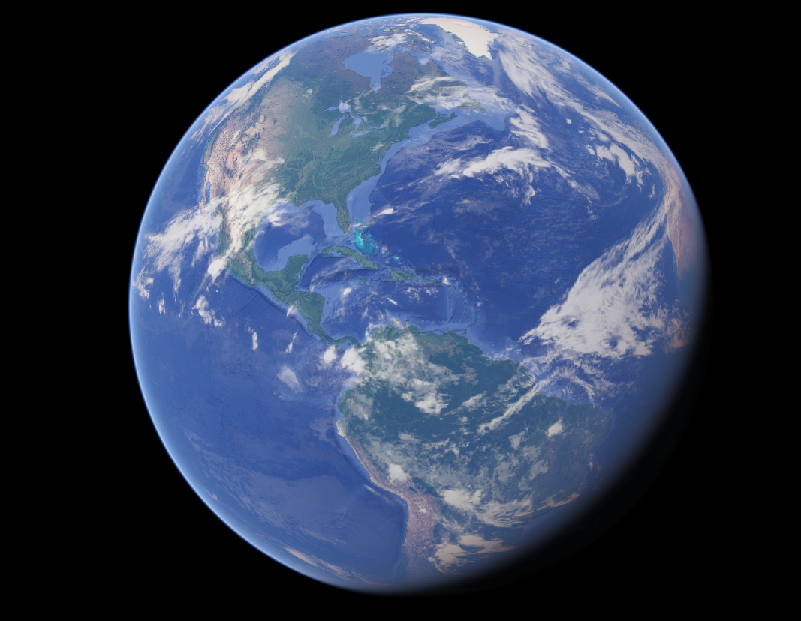
Engineering is Love

